Slide 1
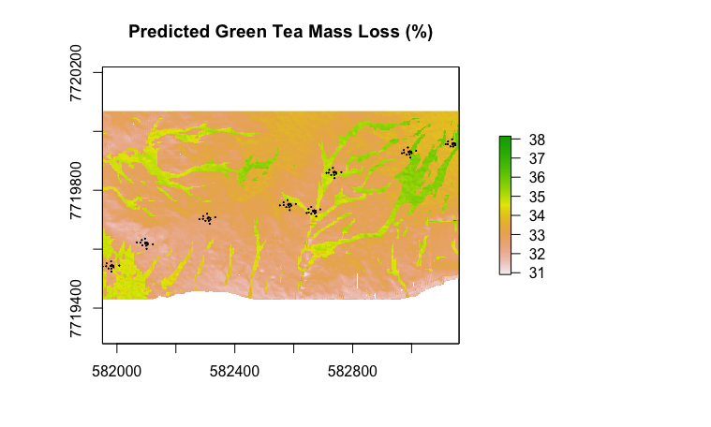
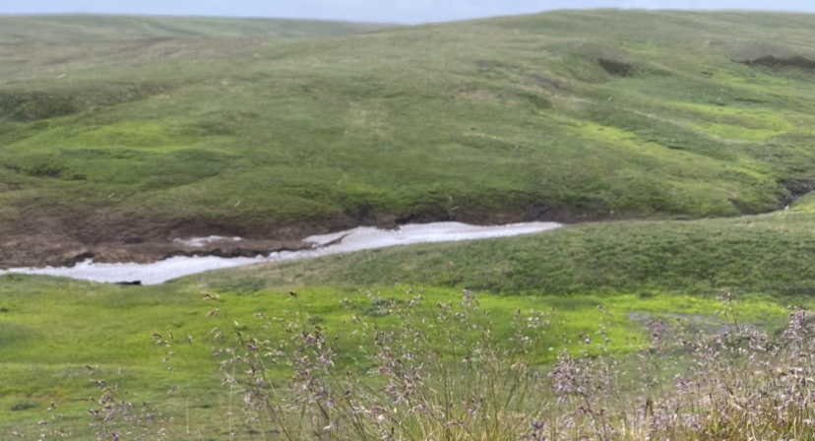
Estimated hotspots of Green Tea Mass Loss (%)
Dry site:
Lower soil moisture content, shallow active layer depths, less litter mass loss
Floodplain site:
Creek sites:
Higher soil moisture content, deeper active layer depths, more litter mass loss
Varying soil moisture content dependent on aspect and proximity to creek, varying levels of litter mass loss

